Slide 1

Introducing the Crime Reporting App
This innovative crime reporting app empowers citizens to easily and securely report suspicious activities or incidents in their community. With user-friendly features and a focus on data privacy, this app aims to enhance public safety and strengthen the bond between citizens and law enforcement.
Ha

Slide 2
Comprehensive App Features
Real-Time Reporting
Anonymous Reporting
Community Alerts
Users can quickly submit detailed reports of crimes or suspicious behavior with photos, videos, and location data.
The app ensures anonymity for users who wish to report incidents without revealing their identity.
The app can send push notifications to users about nearby incidents or safety warnings.

Slide 3
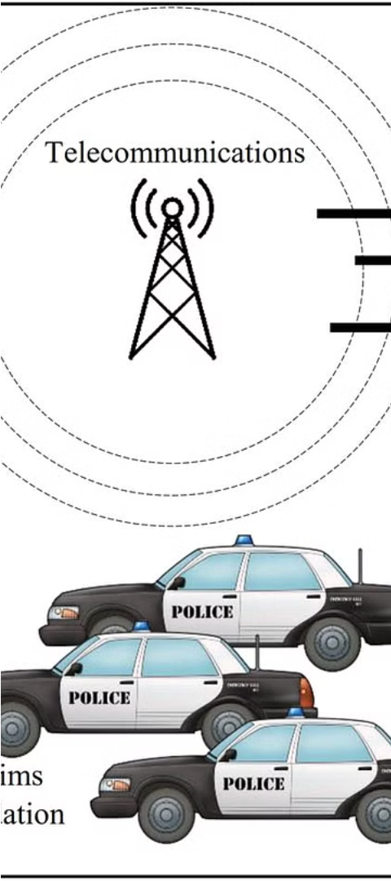
How the App Works
1
Incident Occurs
A user witnesses a crime or suspicious activity in their community.
2
Report Submission
The user opens the app and provides details about the incident, including photos, videos, and location.
3
Data Processing
The app securely transmits the report to law enforcement for review and investigation.

Slide 4

Benefits of Using the App
1
Improved Public Safety
2
Increased Civic Engagement
3
Enhanced Data-Driven Policing
The app helps law enforcement respond to incidents more quickly and effectively.
Users feel empowered to play an active role in improving their community.
The app provides valuable data to help law enforcement allocate resources and identify crime patterns.

Slide 5

Reporting and Privacy Safeguards
Secure Reporting
Anonymous Submissions
Responsible Data Use
The app uses encryption and secure data transmission to protect user information.
Users can choose to remain anonymous when reporting incidents, ensuring their safety and privacy.
The app's data policies prioritize user privacy and only share information with law enforcement when necessary.

Slide 6
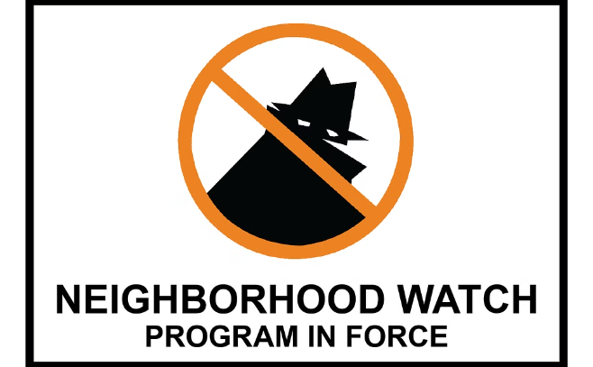

Success Stories and Testimonials
Neighborhood Watch Success
Citizen Feedback
"This app has made me feel safer in my community and empowered to take an active role in keeping my neighborhood secure."
The app helped a local neighborhood watch group coordinate and report suspicious activity, leading to the arrest of a burglary suspect.

Slide 7
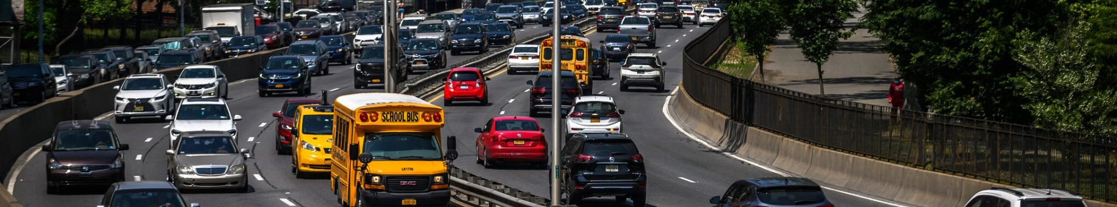



Challenges and Limitations
User Adoption
False Reporting
Data Integration
Encouraging widespread adoption of the app remains a key challenge to maximize its impact.
The app must maintain robust measures to prevent misuse and false reporting of incidents.
Seamless integration with law enforcement systems is crucial for efficient incident response.

Slide 8



The Future of Crime Reporting
Mobile-First Design
AI-Powered Insights
Collaborative Approach
Continued improvements to the app's user experience and mobile functionality.
Leveraging data analytics and machine learning to identify crime patterns and predict incidents.
Fostering stronger partnerships between citizens, law enforcement, and community organizations.

